Slide 1
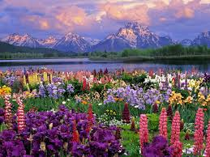
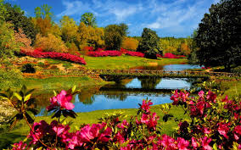
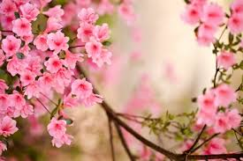
這是天父世界
This is my Father's World

Slide 2
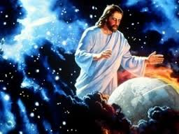
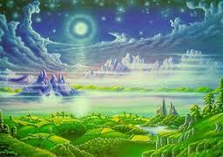
這是天父世界
我們侧耳静听
宇宙唱歌，四围响应
星辰作乐同声
This is my Father's world
and to my listening ears
all nature sings and round me rings
the music of the spheres
This is my Father's world 1/6

Slide 3
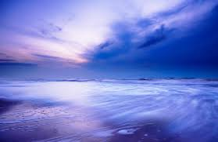
這是天父世界
我心满有安宁
花草树木, 穹苍碧海
述说天父奇能！
This is my Father's world
I rest me in the thought
of rocks and trees, of skies and seas
His hand the wonders wrought
This is my Father's world 2/6

Slide 4
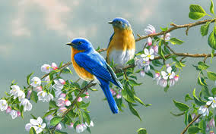
這是天父世界
群鸟欢唱齐鸣
清晨明亮，百花美丽
显明创造精深
This is my Father's world
the birds their carols raise
The morning light, the lily white
declare their maker's praise
This is my Father's world 3/6

Slide 5
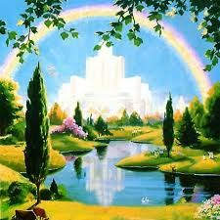
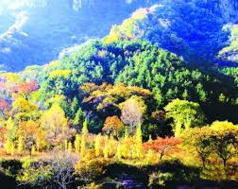
這是天父世界 他爱普及万千
风吹草声， 知他经过 随处能听他言
This is my Father's world
He shines in all that's fair
In the rustling grass I hear Him pass
He speaks to me everywhere
This is my Father's world 4/6

Slide 6
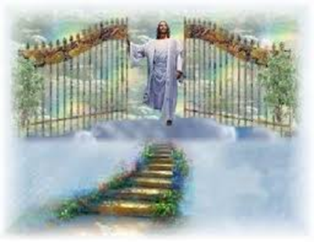
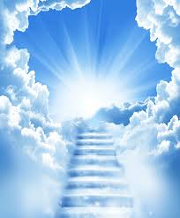
這是天父世界
求主叫我不忘
罪恶虽然好像得胜
天父却仍掌管
This is my Father's world
O let me ne'er forget
that though the wrong seems oft so strong
God is the ruler yet
This is my Father's world 5/6

Slide 7
这是天父世界
我心不必忧伤
天父是王，宇宙同唱
他治万国万方
This is my Father's world
why should my heart be sad
The Lord is King; let the heavens ring
God reigns; let the earth be glad
This is my Father's world 6/6

Slide 8
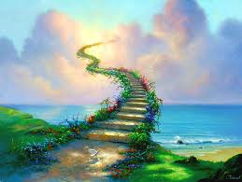
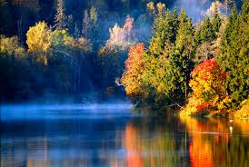
這是天父世界
This is my Father's World

